Slide 1
CORS
Cross-Origin Resource Sharing

Slide 2
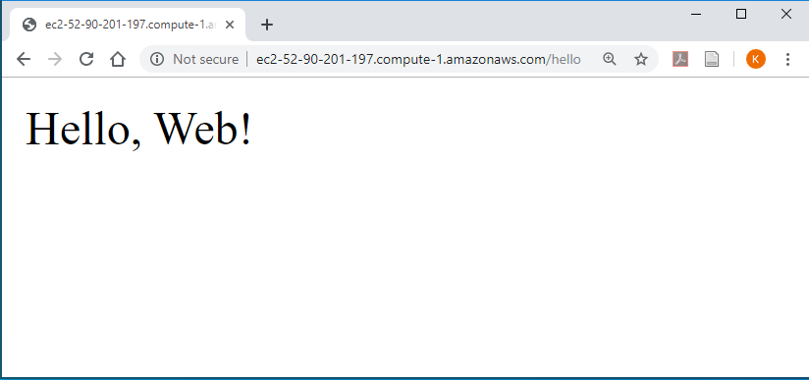



Cookies on sites before 1999
My site in browser
Username: ____
Pwd: ______
Login
Log in (send pwd)
New page, with cookie
My page server
Another Request
My private info
My site cookie
Another new page

Slide 3
Cookies with Ajax (Gmail 2004, Google Maps 2005)
My page server
Log in (send pwd)
My site in browser
Accept login, set logged-in cookie
Subsequent Request
My site cookie

Slide 4
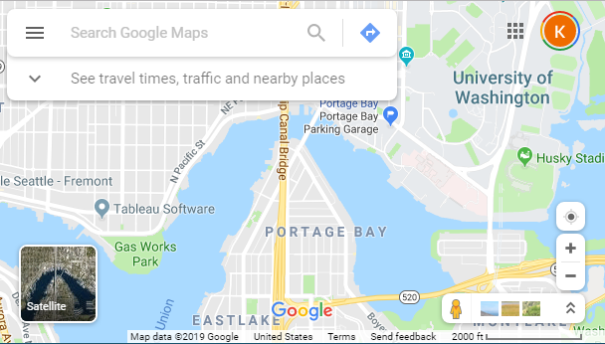
Cross Origin Requests
My page server
Load my page
My site in browser
Google maps server
Interactively Load Map

Slide 5
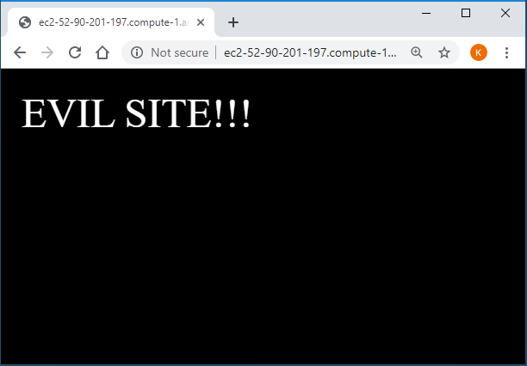
Cookies
Malicious Site
My page server
Cross-Origin Request
Sensitive Information
My site cookie

Slide 6
CORS protections
Malicious Site
My page server
Cross-Origin Request
Origin: evil.com
Sensitive Information
Access-Control-Allow-Origin: *
OR
Access-Control-Allow-Origin: evil.com
My site cookie

